Slide 1
WEB DEVELOPMENT
PC POWERPOINTPRESENTATION
ASHLY ROSE ANTONY
17
S2 CSE A

Slide 2
CONTENTS:-
web
Web development
Web developer
Programming languages
front end development
Back end development
Full stack development
Courses
references

Slide 3
WEB (WORLD WIDE WEB)
World wide web is originally designed in 1991 by Tim Berners Lee.
www it means interlinking webpages.
Web pages are written in HTML.

Slide 4

Who is a web developer?
One who develops website and maintains it.
WEB DEVELOPER/WEB PROGRAMMER : someone who takes a web design - which has been created by either a client or a design team - and turns it into a website.

Slide 5
Some of the popular Programming/web languages :
HTML
CSS
JAVASCRIPT
PHP
JAVA

Slide 6
1.HTML
<html>
<head>
<title>….</title>
</head>
<body>
</body>
</html>
Hyper text markup language
It defines the basic framework of web site-foundation upon which everything is built upon.
It forms the blocks that defines a page’s layout, format &critical components.

Slide 7
2. CSS
3. Java script
CASCADING STYLE SHEETS
It is used to style the contents of a website.
Used to format layout of webpage.
It is a famous scripting language
Used to create magic on sites to make site interactive & attractive for users.

Slide 8
4. PHP
5. JAVA
developers to learn. Hypertext preprocessor(Personal home page)
Server slide scripting language designed specifically for web development.
Slowly decreasing it’s popularity it still a great language for any back end
Essential language for back end developers.
It is a Old language popular , easy to learn, easy to use , easy to maintain .
Super scalable

Slide 9

WEB DEVELOPMENT
FRONT END DEVELOPMENT
BACK END DEVELOPMENT
FULL STACK DEVELOPMENT

Slide 10
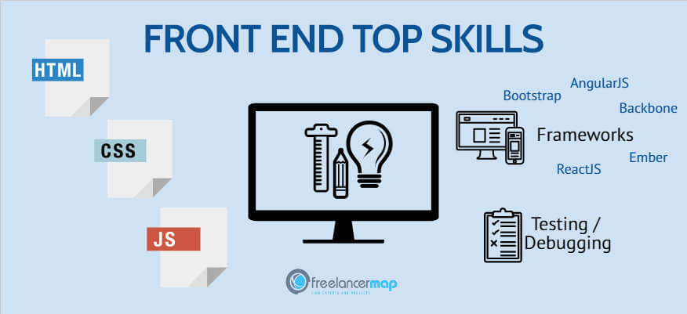
Front end development
‘CLIENT SIDE’ OF APPLICATION
: The part of a website that user interacts with directly is termed as front end.
It includes everything that user experience directly .text color ,styles ,images ,graphs ,navigation menus…..

Slide 11

Back end development
Backend is ‘server side’ of the website.
It is the part of the website that you cannot see and interact with.
It handles all the complex tasks like data organization and storage .
communicates with the front-end to make sure that the site is running smoothly.

Slide 12
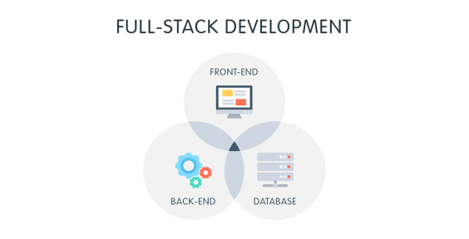
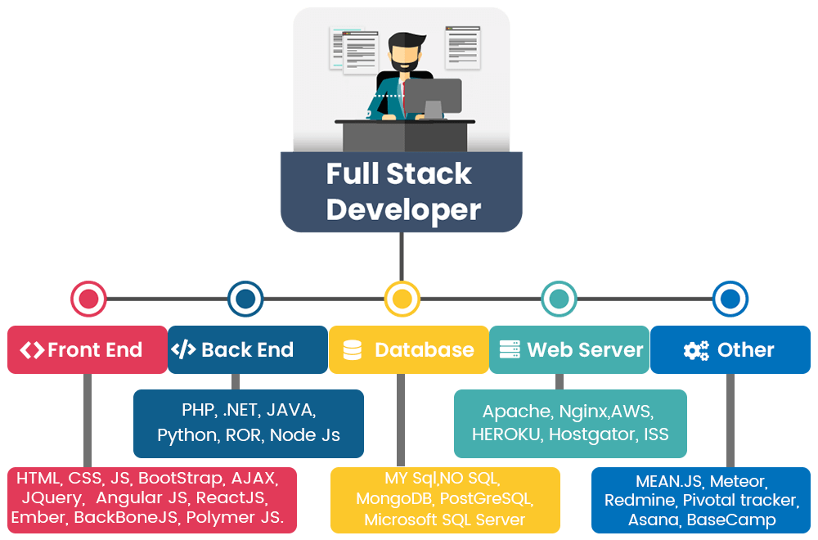
Full stack development
It take care of all visual aspects of websites(layout ,navigation bar)interactivity &binds together all its elements.
Able to do both front end and back end tasks at the same time.

Slide 13
Courses :
For web development , programming languages such as python ,C++,java….
Are available on:-
COUSERA
UDEMY
UDACITY
FREEHOUSE
KAGGLE
EDX……

Slide 14
REFERENCES :-
WWW.Quora.com
www.greeksforgreek.com
www.pinterest.com
www.youtube.com
www.w3school.com

Slide 15
THANK YOU

